Slide 1

Customer Segmentation: Online Retail
A Springboard Capstone Project
Eduardo Mosada Jr.

Slide 2
The Problem:
How can an online retailer target specific groups of customers for its marketing campaigns and strategies based on their purchasing patterns?

Slide 3
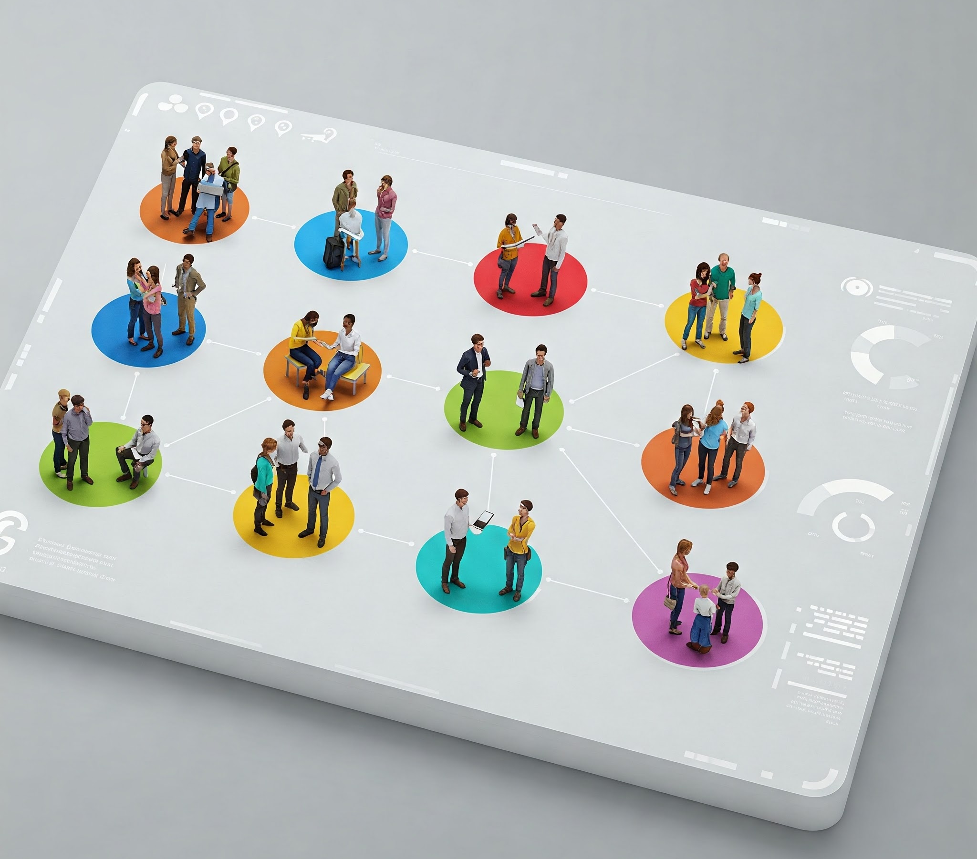
Objectives:
Valuable insights into customer purchasing behavior
Customer-centric data anchored on RFM features
Segmented customers based on RFM analysis.
Benefits:
Better understanding of customers' behaviors and ever-changing needs
Targeted Marketing Campaigns/Strategies
Enhanced Customer Experience
Drive innovative and creative solutions
Boost product sales and profitability
Promising outlook for the future

Slide 4

The Data:
UK-based all-occasion gift-ware online retailer
500,000+ transactions in 2010
4,000+ customers recorded
Data Source: UCI Machine Learning Repository | Online Retail II

Slide 5
Data Wrangling
541,910 Sales transactions in 2010
25 % Blank Customer IDs - 135,080
1.6 % Negative values in quantity – 8,905
1 % Duplicate records – 5,192
72.5%: Records retained – 392,733

Slide 6
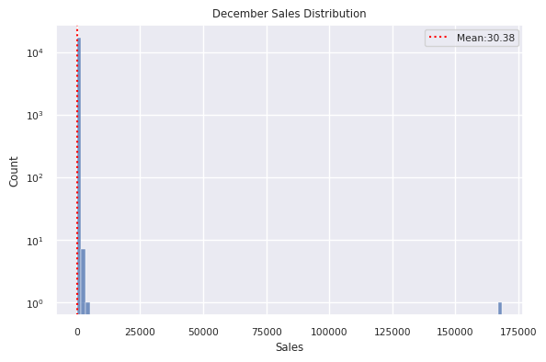
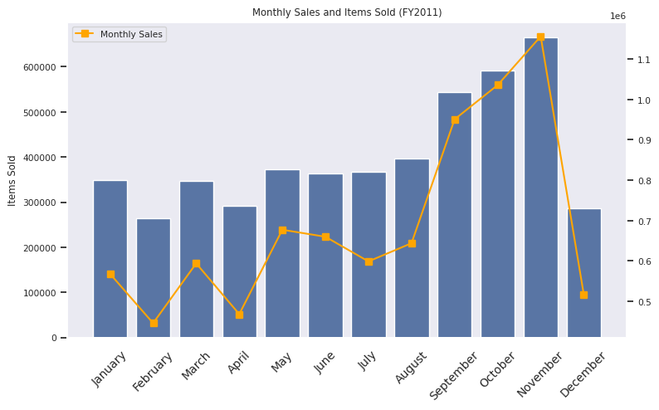
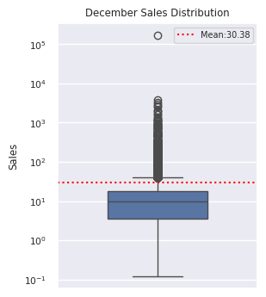
Exploratory Data Analysis
Analysis of 55% Dip in December Sales
392,733 Records for EDA
40 Zero-Priced items
2,560 Out of range Invoices
367,023 Records processed
17,132 Invoices
4,219 Customer IDs
3,596 Stock codes
36 Countries
Huge number of low-value transactions
December only accounted for 5% of the total transactions for the current year
Last transaction is December 9
Incomplete transactions

Slide 7
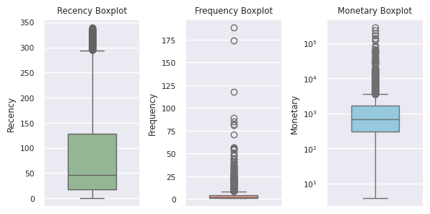
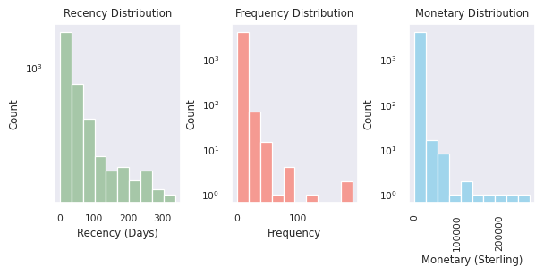
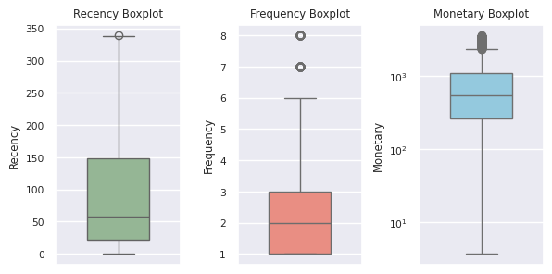
Pre-Processing
Dealing with outliers
Feature Engineering
Recency - How long since the customer's last purchase date?
Frequency - How many transactions did the customer have?
Monetary - How much was spent by the customer?
Outliers for further analysis
402 Monetary outliers
412 Frequency outliers
269 M x F outliers
Non-outliers for modeling
87 % Non-outliers – 3647
3,647 – Scaled data

Slide 8
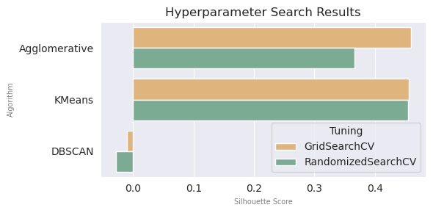

Clustering Algorithm Options
KMeans Clustering
Agglomerative Hierarchical Clustering
DBSCAN
Hyperparameter Seach Implementation
Modeling
3 clustering algorithms
2 Cross-Validation (Nested CV)
Scoring function: Silhouette Score

Slide 9
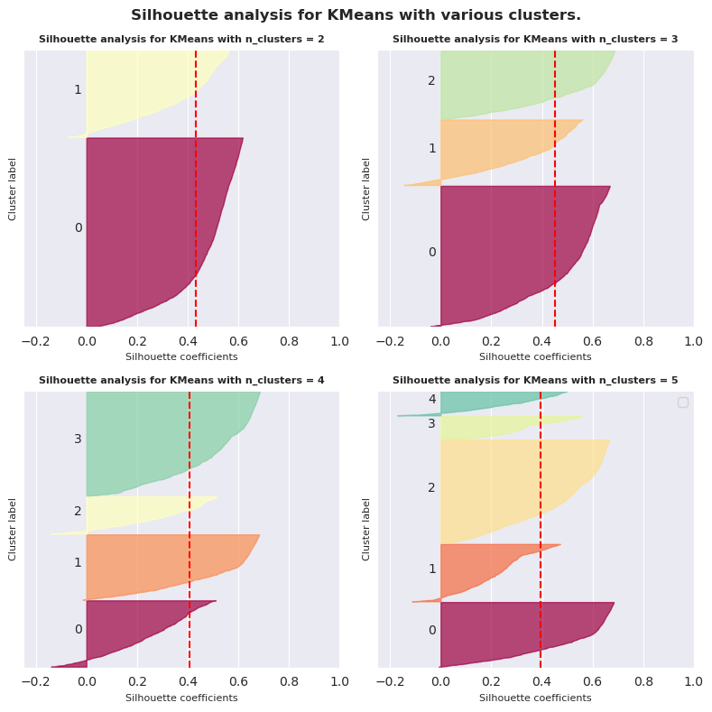
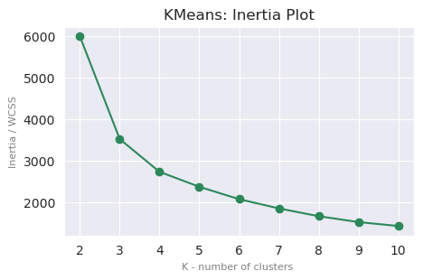
Modeling cont’d.
Cross-Validation vs. Sequential Model-Based Optimization SMBO Search
Optimal K- no. of clusters: Silhouette Analysis
Tuning | Inertia | Silhouette Score
SMBO | 5989.735 | 0.432
RandomizedSearchCV | 3521.054 | 0.453
GridSeachCV | 3517.192 | 0.453
SMBO hyperparameters:
algorithm : 'lloyd’
init: 'random’
max_iter: 645
n_clusters: 2
n_init: 5
tol: 0.1
Optimal K- no. of clusters : Inertia Plot
-- Elbow point
Deciding between n_clusters= 3 and 4 -> Silhouette Analysis
Optimal K- no. of clusters: 3

Slide 10
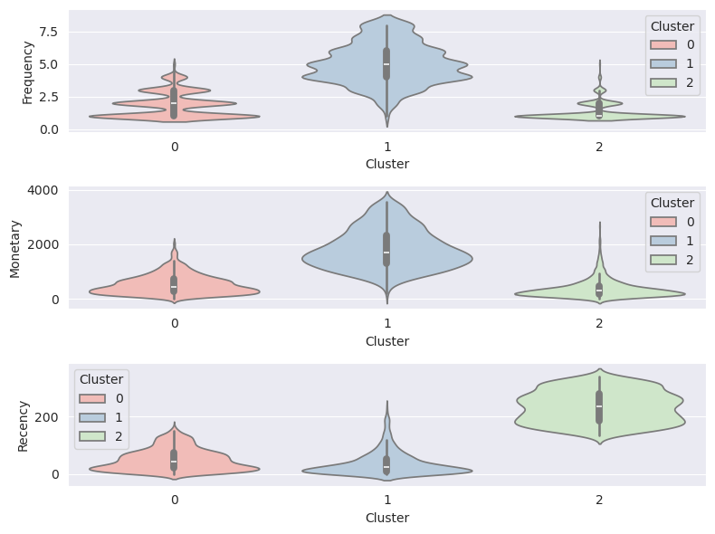
Modeling cont’d.
Cluster Analysis
Assigning Labels
Cluster 0: Moderate
Moderately frequent buyers
Not necessarily high spenders
Majority made recent purchases
Cluster 1: Loyal
Frequent buyers
High spenders
Majority made recent purchases
Cluster 2: At-Risk
Least active recently
Less frequent buyers
Low-spenders

Slide 11
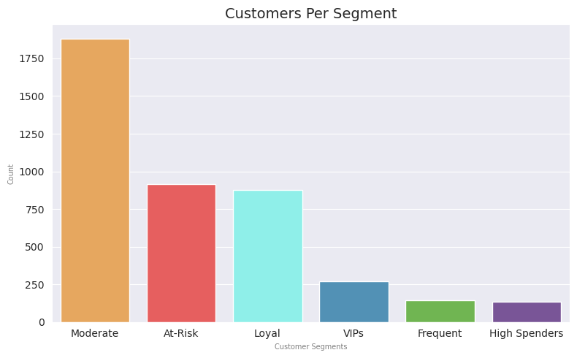
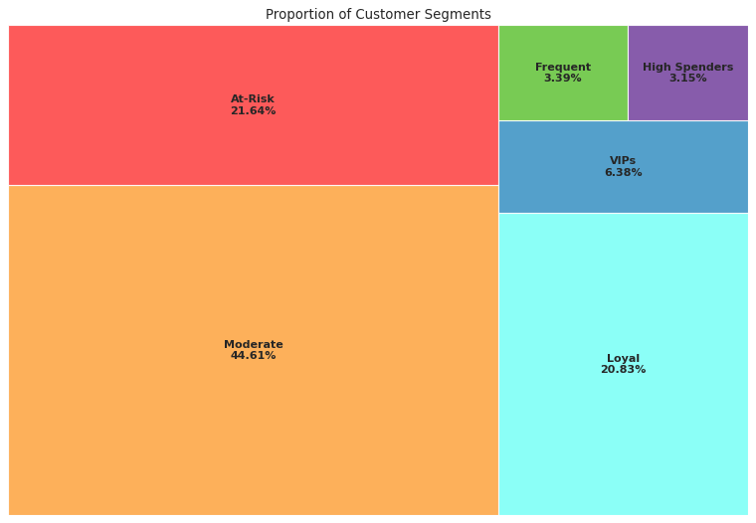
Summary
Customer Segmentation
Customer Segmentation Analysis and Recommendations
Segment | Description | Recommendations
MODERATE | Moderately frequent buyers that are not necessarily high spenders. Majority in this segment made recent purchases. | Offer subscription on frequently bought items (whenever applicable) Recommend "Frequently bought together" items Implement customer retention and loyalty programs
AT-RISK | Least active segment. Less frequent buyers who are low-spenders and have minimal recent purchases. | Requires attention and re-engaging Perform sentiment analysis. Send surveys and ask for reviews or feedback. Identify areas for improvement to enhance the overall buying experience Whenever possible, drop small rewards, such as reactivation bonuses or discounts on their next purchase. Tease or entice with the benefits of becoming active or loyal customers
LOYAL | Frequent buyers who are high spenders, and with its majority having purchased recently. | Implement rewards and loyalty programs, and exclusive perks Run targeted ads for trending items and top items sold Offer subscription on frequently bought items (whenever applicable)
VIPS | High value, frequent buyers. | Offer exclusive perks and vouchers Pamper and enhance the shopping experience by offering expedited or free shipping (whenever applicable)
FREQUENT | Very frequent buyers. | Offer subscription on frequently bought items (whenever applicable) Implement customer retention and loyalty programs Offer expedited or free shipping vouchers (whenever applicable)
HIGH SPENDERS | High-spending buyers | Implement customer retention and loyalty programs Offer discounts on bulk purchases or reaching certain amount (whenever applicable) Enhance customer experience and services

Slide 12

Recommendations and Next Steps:
Evaluate the feasibility of launching targeted marketing campaigns
Develop and periodically monitor metrics
Effectiveness of marketing campaigns
Implementation of new processes
Customer responses and sentiments
> Do sales, profitability, and customer engagement/retention improve over time?
Explore additional customer segmentation methods beyond RFM analysis
Sentiment Analysis on existing and future products and offerings
Revisit data gathering process
IT landscape transformation
Omnichannel approach for seamless experience
Recommendation systems to introduce product recommendations

Slide 13
Sources:
Github Project Repository | Customer Segmentation for an Online Retail
Machine Learning Libraries | Scikit-Learn Clustering Hyperopt Hyperparameter Optimization
Data Source | UCI Machine Learning Repository | Online Retail II
Special Thanks:
Jyant Mahara (Springboard Mentor) | https://www.linkedin.com/in/jyant-mahara-95877b93/

Slide 14



Thank you
Eduardo Mosada Jr.
edu.mosada.jr@gmail.com
https://github.com/ds-edu/ https://www.linkedin.com/in/edumosada/

